Slide 1
www.ctdigitalnewspaperproject.org

Slide 3
Connecticut Social Studies Framework –HS History
From the 1870s - present
Focus on inquiry not facts
Changes in society & economic development
Variety of sources & perspectives.
Guided investigation of compelling questions

Slide 4
Secondary Social Studies Framework--High School History
Theme: . . . conceptions of freedom and equality changed over the course of U.S. history for members of various racial, ethnic, religious, and gender minority groups?
Content Areas:
Civil rights movements of early 20th c.
Progressivism (Progressive Era Reform) Industrialization & Rise of Organized Labor
Immigration
Suffrage
Emergence of US as global power

Slide 5
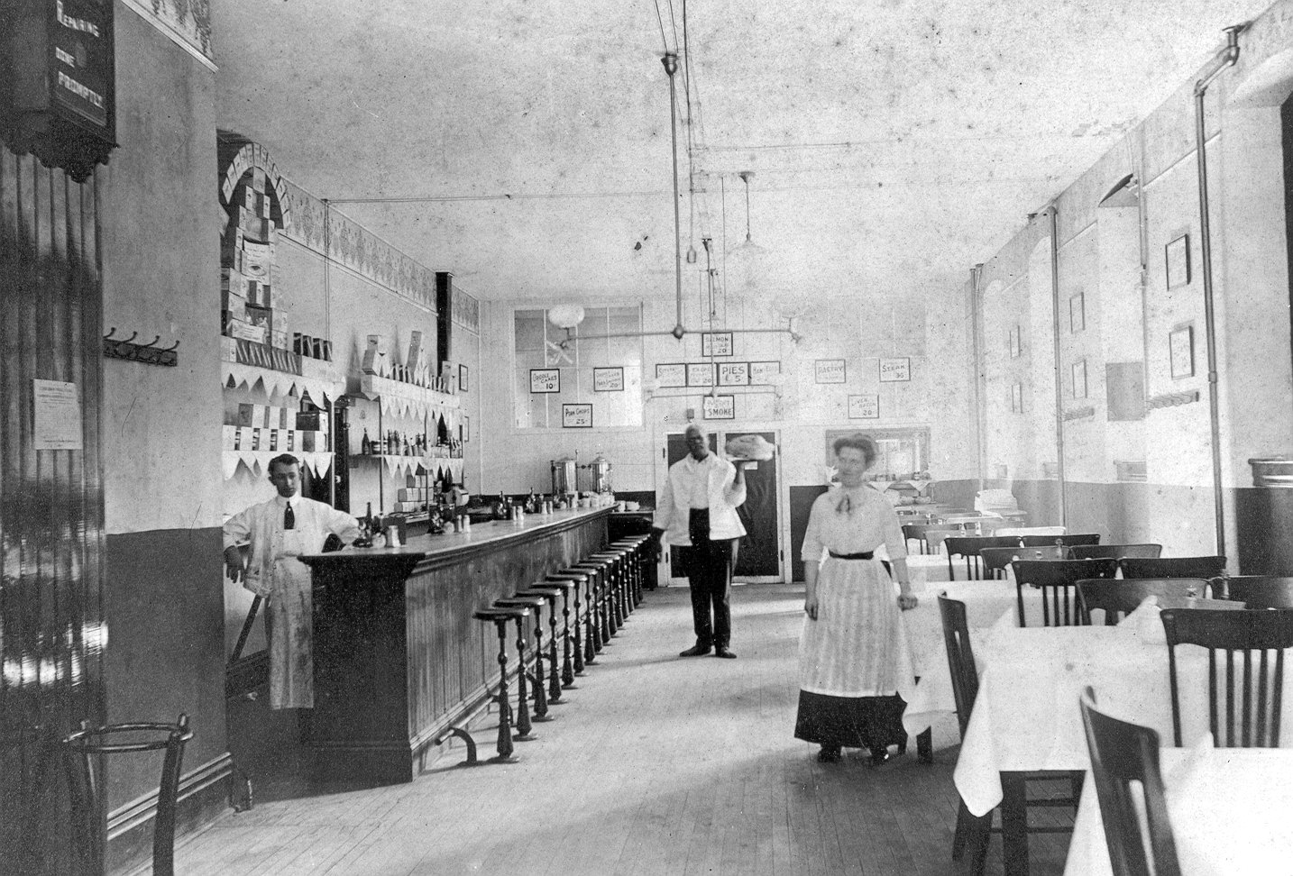
Compelling Questions
How have American concepts of freedom and equality changed over time?
Has America/Connecticut always been a “land of opportunity”?
Do laws and rules promote or hinder freedom and equality?

Slide 6
Historic State Newspapers
Gilded Age & Progressive Era
New Haven Journal Courier, 1880-1908
Waterbury Democrat, 1887-1908
Newtown Bee, 1877-1909
Bridgeport Evening Farmer, 1909-1922
Norwich Bulletin, 1909-1922
What can be found in newspapers of record?

Slide 7
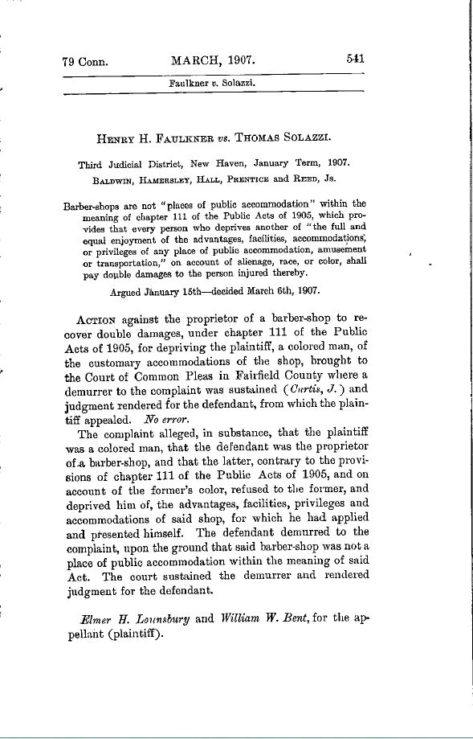
Connecticut Supreme Court rules that a barber-shop was NOT a place of public accommodation, March 1907
June 2017

Slide 8
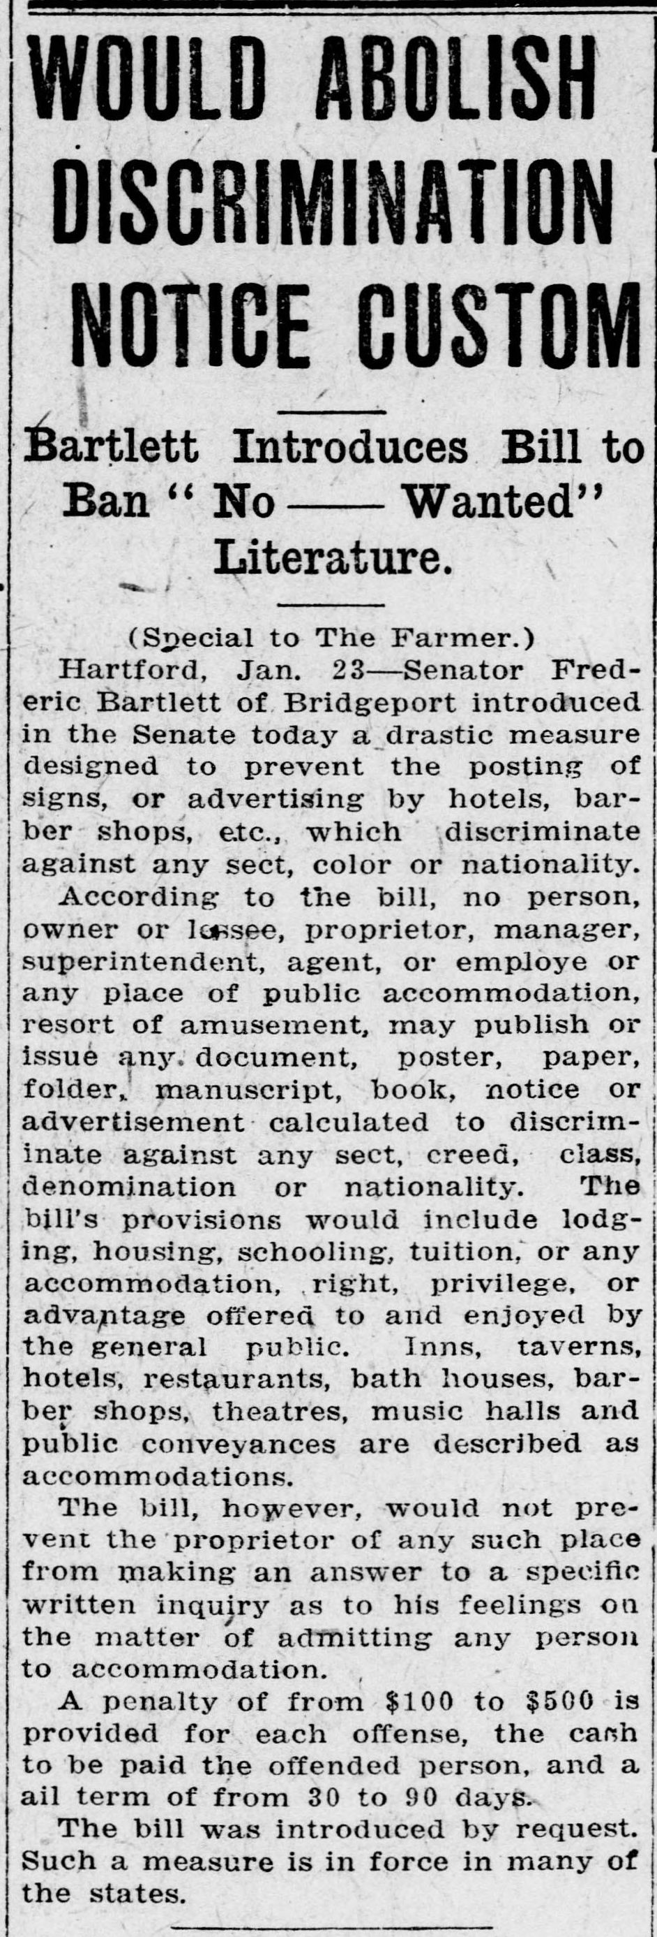
Using Historic Newspapers for Inquiry- Based Instruction
Bridgeport Evening Farmer, January 23, 1917

Slide 9
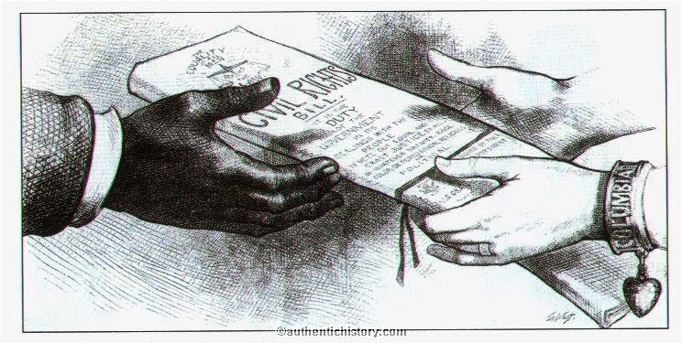
The Civil Rights Bill of 1875, which outlawed discrimination in public accommodations, was declared unconstitutional by the U.S. Supreme Court in 1883.

Slide 10
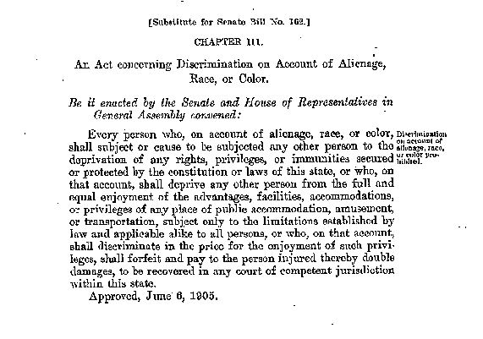
Activists Turn to State Bills to End Discrimination in Public Accommodations in the North

Slide 11
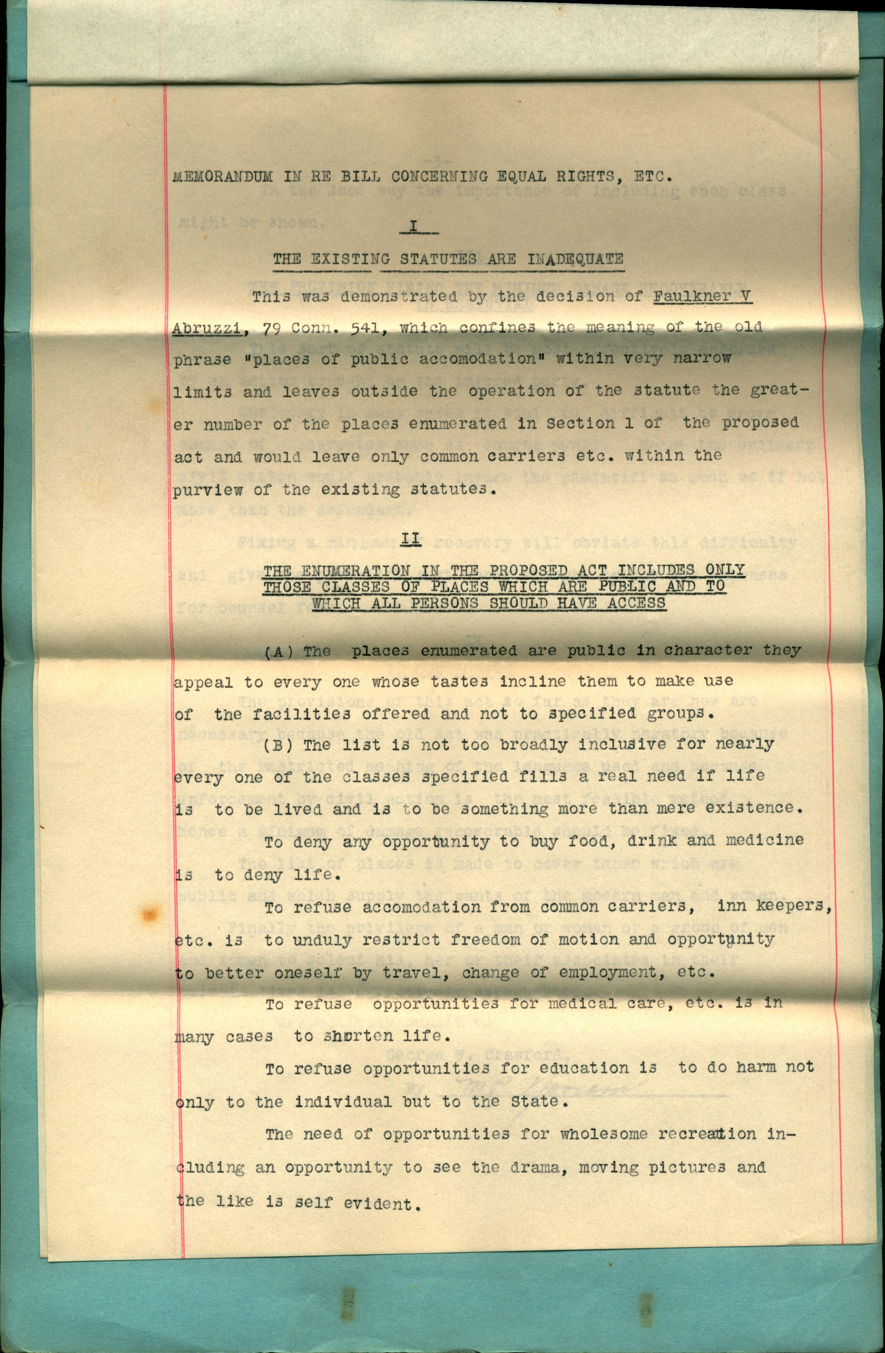
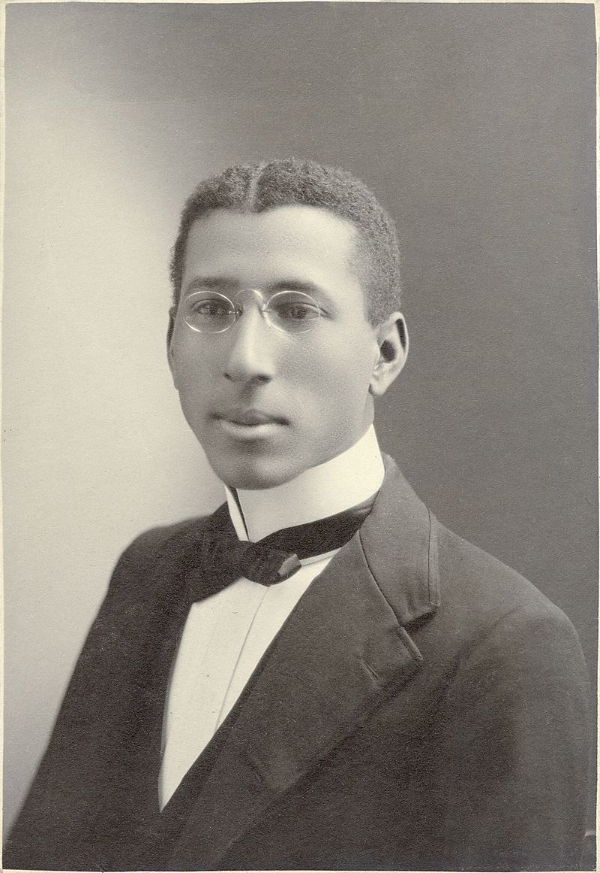

Slide 12
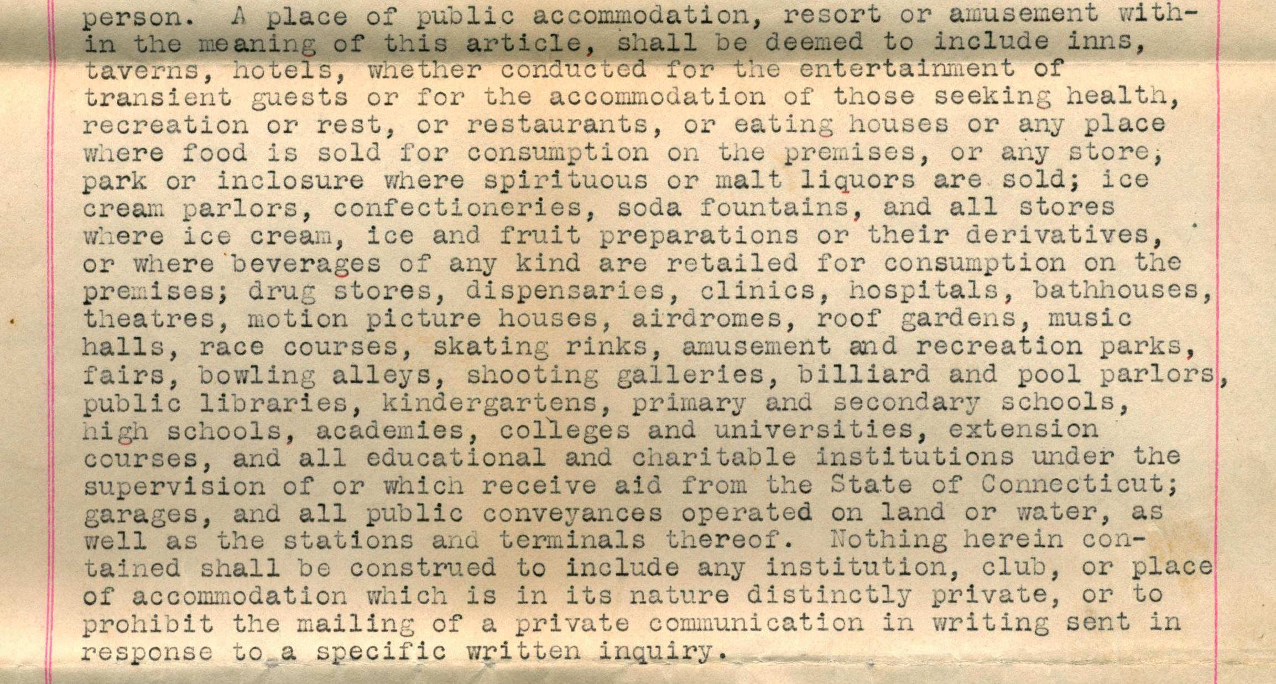
Excerpt, An Act Concerning Equal Rights, 1919

Slide 13
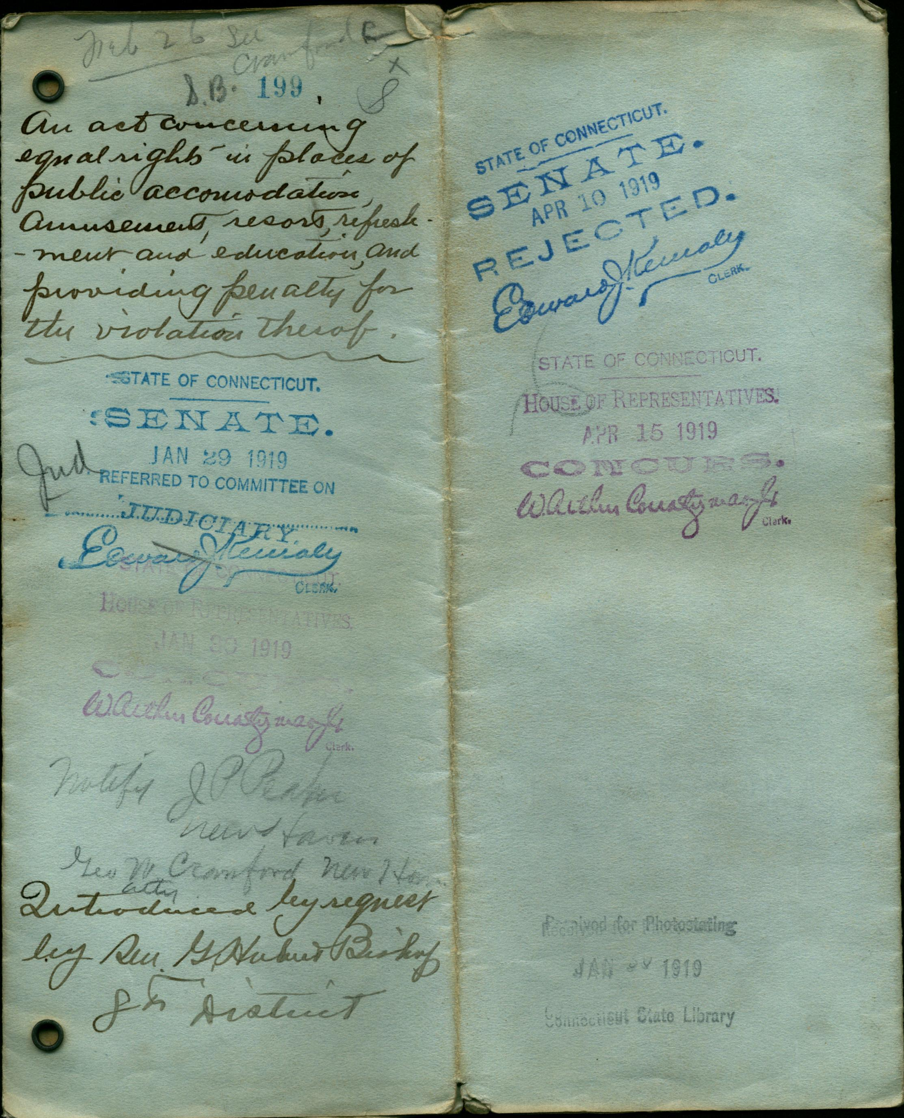

Slide 14
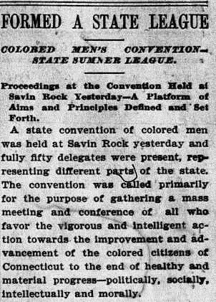
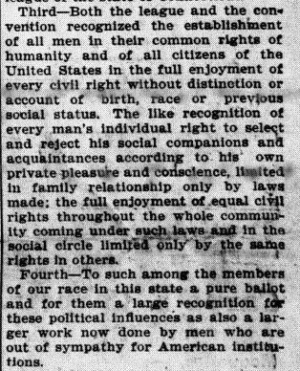
CT State Sumner League Founded, 1894

Slide 15
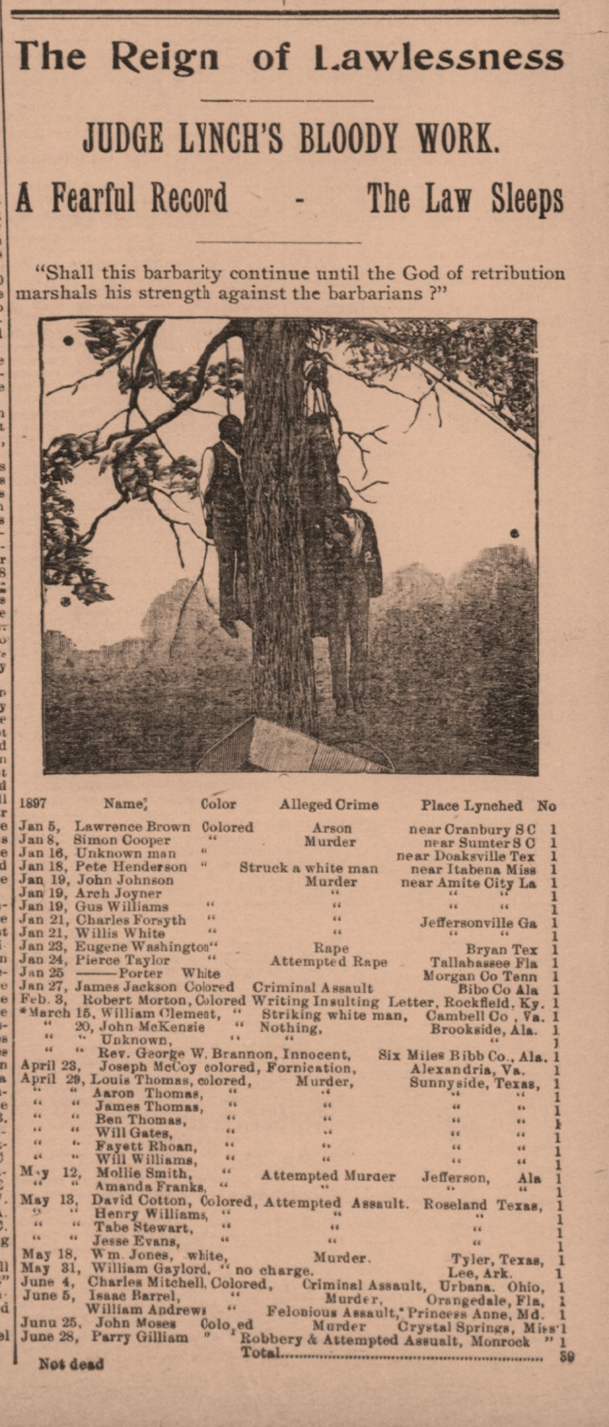
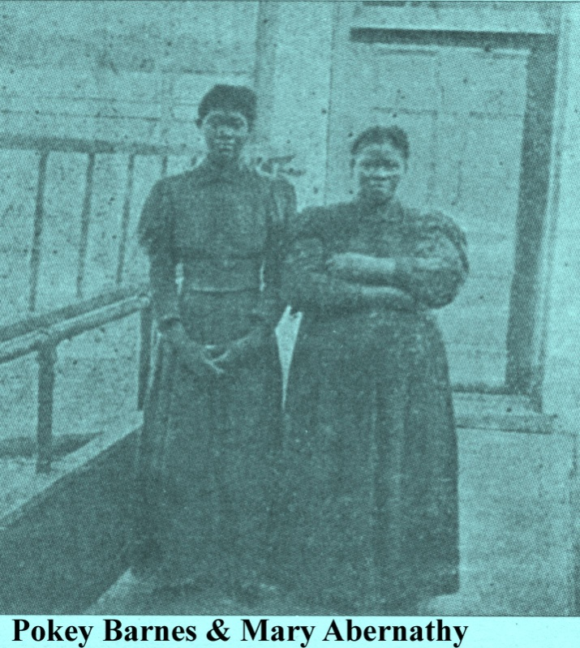

Slide 16
58 African American Newspapers are digitized in Chronicling America

Slide 17
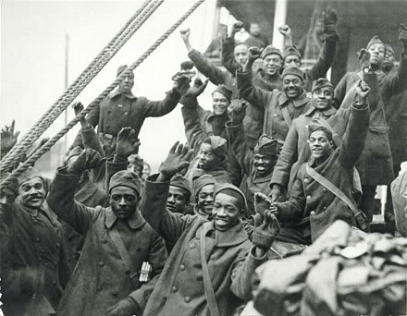

Slide 20
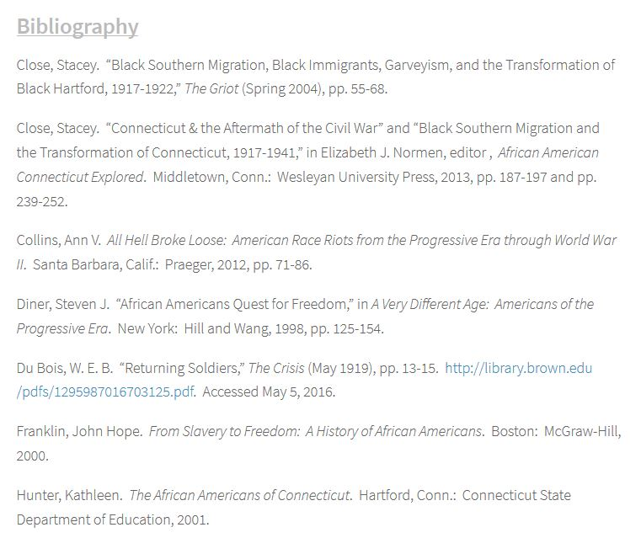

Slide 22
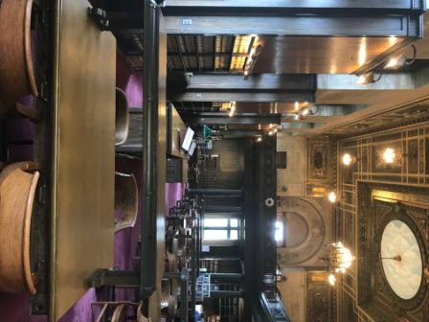
Bound Volumes & Card Catalogues of CT Public Acts, Statutes, Supreme Court Decisions, Senate and House Records

Slide 23
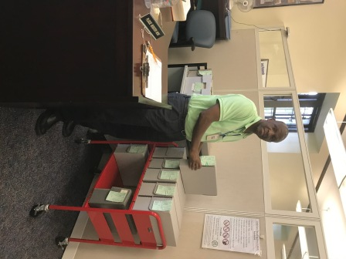
Supplementary materials for rejected bills are on the manuscript collection

Slide 27
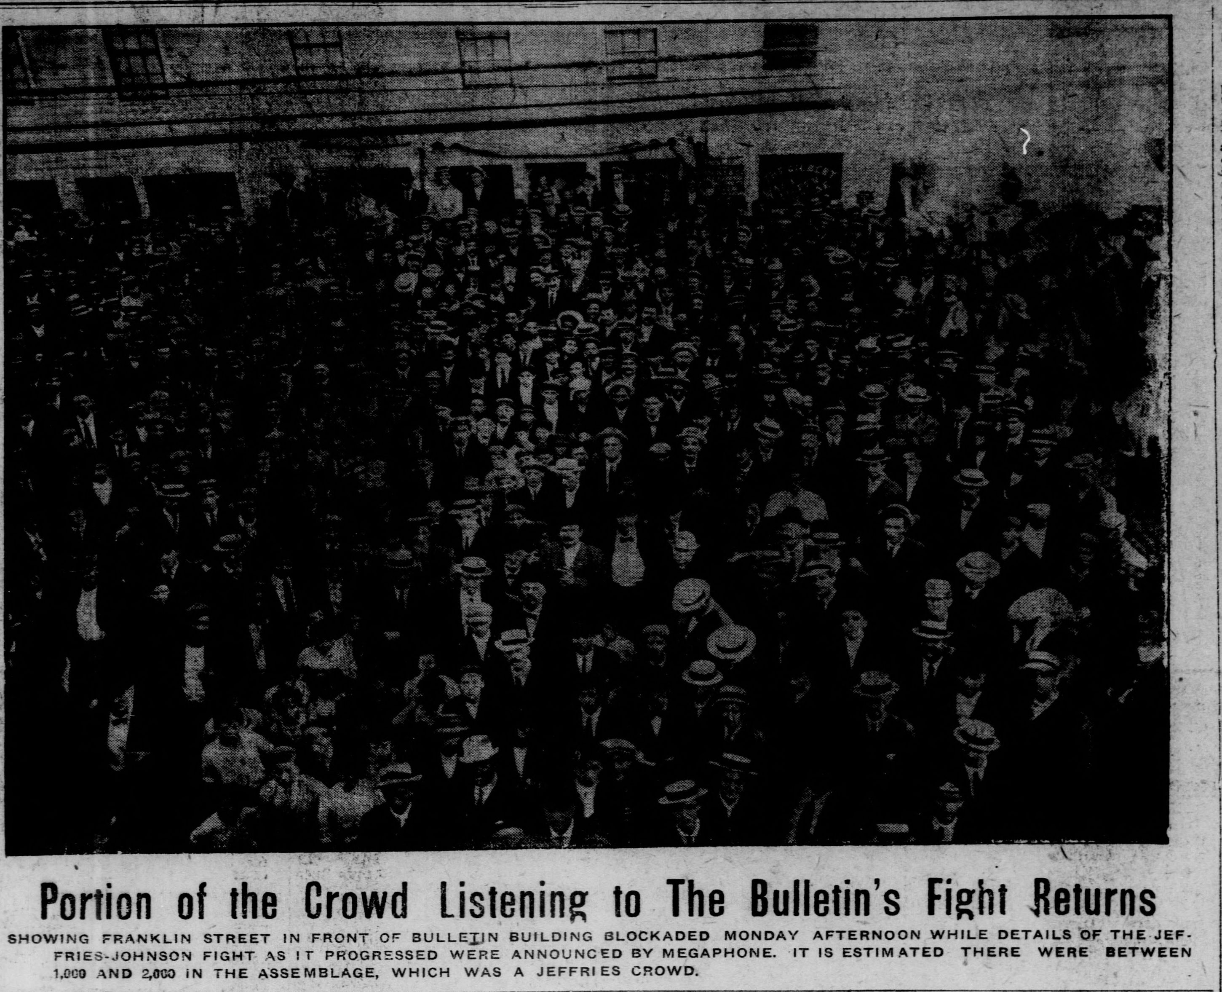
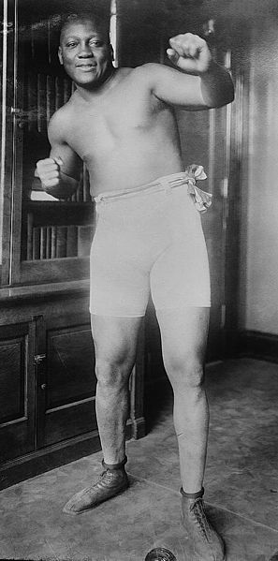

Slide 29
